Slide 1






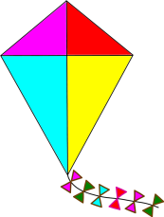




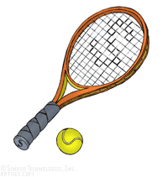



Jolly Phonics
Claire Williams

Slide 2
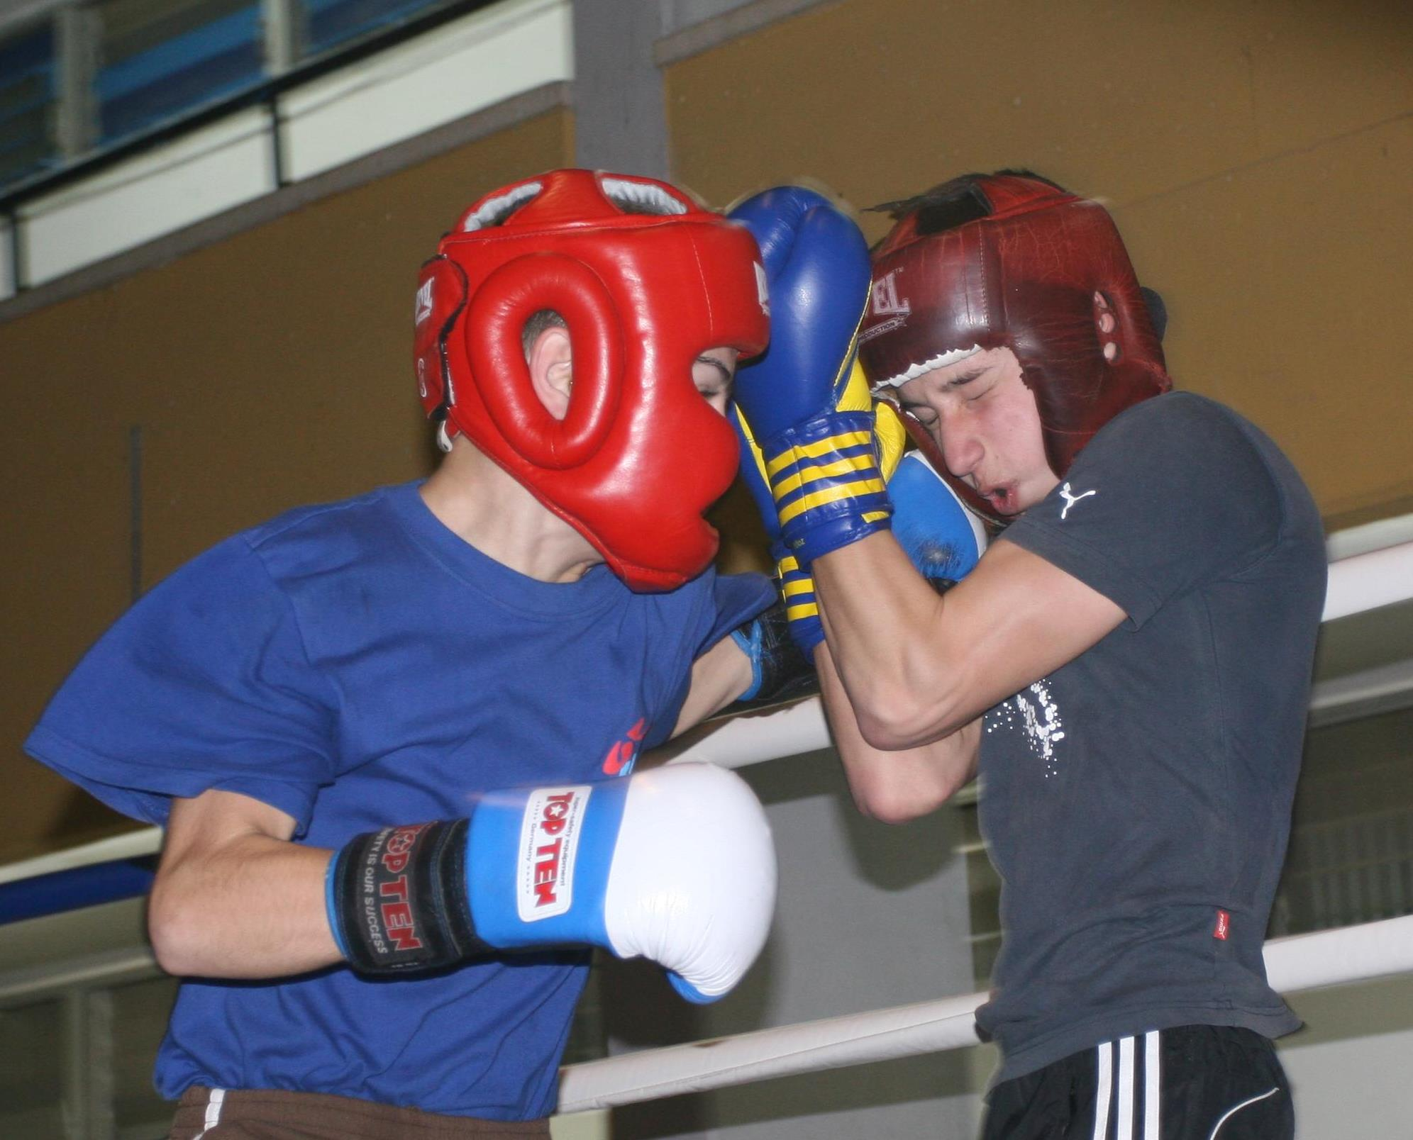
The Reading Wars
1998 - Whole language approach to literacy based on psycholinguistic principles.
Searchlight model of reading incorporated sematic, syntactic and graph-phonic cues.
2006 – The Simple View of Reading. Based on principles of cognitive development. (Rose 2006)
Focus on developing phonological skills first.
Notes:
Theories of reading and writing acquisition differ. Whole language vs phonic approaches
When JP was first created whole language approaches were popular. These were based on psycholinguistic principles and encouraged a holistic approach to understanding texts.
E.g.the cue-system model which suggests that three mutually required cuing systems are needed to read. Semantic cues which draw upon previous knowledge gleaned from earlier on in the text (including pictures) as well as a general knowledge of books. Syntactic cues where the expected pattern of language within a sentence provides clues about the type of word that may be required (e.g. noun or verb). Grapho-phonic cues are used to map the graphological appearance of letters to the phonological sounds they represent.
This model suggests that all readers, regardless of their stage of development, call upon the same process. What differs is their degree of control over the various cues, which improves with time.
This theoretical model was adapted into a teaching strategy where learners were encouraged to read by applying a series of ‘searchlights’ which incorporated all three cues. This model was adopted by the National literacy strategy (DfEE 1998) and governed the teaching of reading until 2006.
The psycholinguistic model was challenged by a cognitive psychological stance
Learning to read is a staged, linear process with decoding symbols (letters or graphemes) into sounds (phonemes) as the first step
Beginner readers rely on grapho-phonic cues alone, sounding out words grapheme by grapheme and matching them with their phonemic representation.
They will draw upon the other contextual cues later on in their development.
In this sense the cognitive psychological model is a bottom up approach where children are taught to first map sounds with letters or combinations of letters and blend these together in order to read whole words. Phonological awareness is a necessary perquisite to word recognition and needs to be taught explicitly for children to be able to read and spell.
In 2006 Sir Jim Rose (DfES 2006a) recommended that the searchlight model be replaced with a strategy more in line with the cognitive psychology.
Thus the ‘simple view of reading’ model was developed which focuses beginner readers with a series of phonics lessons. Rose (2006) suggests that, ‘high quality, systematic phonics offers the best and most direct route to becoming skilled readers’.

Slide 3

What is Jolly Phonics?
Sue Lloyd (1992)
An approach to teaching early literacy
Building up 42 letter sounds
Forming letters in a multisensory approach
Teaching blending and segmenting
Daily delivery
Whole class approach
A, A ants on my arm, causing me alarm
Notes:
Created by Sue Lloyd
Sue Lloyd taught for over 20 years in a Primary School (Suffolk).
In the late 1970s, the method of teaching reading was ‘Look and Say’, where children were expected to look at whole words and memorise each one and then learn sounds.
Within her school, she began to use synthetic phonic methods for children who were falling behind.
Developed and improved the programme from research, advice and the practical experience.
She noticed a huge improvement in all the children and the scheme was published with Jolly Learning in 1992.
What is Jolly Phonics?
An approach to teaching literacy (reading and writing)
Teaching children all the phonics sounds in the English language. Focus on gaining secure phonic knowledge as the first step in learning to decode letters into sounds which can then lead into whole word recogntion, comprehension and fluent reading.
Focuses on 42 sounds in the English language, not just alphabet sounds e.g. A = ah, b = buh P = puh also teaches sounds like oo (soon), oa (boat)
Taught in a multi-sensory method through songs, actions and pictures – see ants on the arm example
There is a 9/10 week program outlined in the handbook and then teachers’ are encouraged to adapt the skills to daily lessons
Recommended for a whole school / class approach but also for groups or individuals
Jolly phonics provides numerous worksheets, songs and activities which teachers can use in their planning.
How does Jolly Phonics work?
The sounds are taught in a specific order (not alphabetically). This enables children to begin building words as early as possible.
Jolly Phonics teaches children the five key skills for reading and writing which are all taught at the same time.
1.Learning the letter sounds: Children are taught the 42 main letter sounds. This includes alphabet sounds as well as digraphs such as sh, th, ai and ue.
2.Learning letter formation: Using different multi-sensory methods, children learn how to form and write the letters.
3.Blending: Children are taught how to blend the sounds together to read and write new words.
4.Identifying the sounds in words (Segmenting): Listening for the sounds in words gives children the best start for improving spelling.
5.Tricky words: Tricky words which have irregular spellings are taught separately.

Slide 4
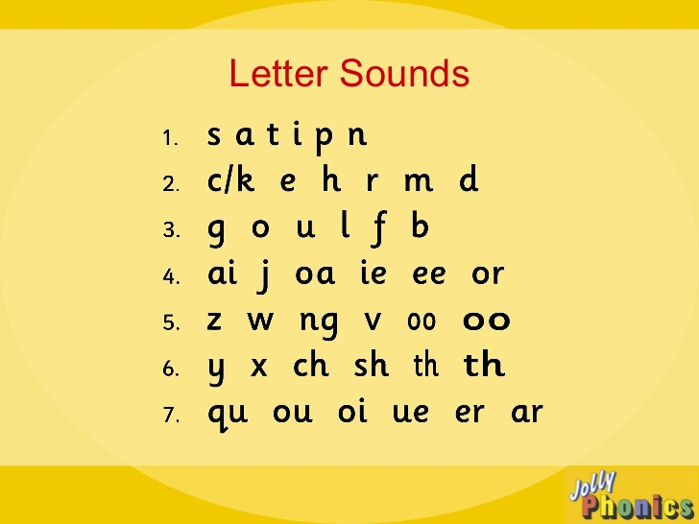

Slide 5
Key terms
Phoneme = smallest unit of sound
Grapheme = symbol used to represent that sound
https://www.youtube.com/watch?v=-ksblMiliA8
Frog
High
Shout
Throne
Eggs in the pan E , E, E
Notes:
Define terms
Phoneme – sound e.g. cat has three units of sound. Night has 3 Not to be confused with syllables
Grapheme – symbol to represent sound c-a-t. N-ight-t
Decoding and encoding
Digraph – e.g. sh
Trigraph e.g. igh
Split digraph e.g. stone – oe
(4 – F-r-o-g)
(2 – H-igh) 1 trigraph
(3 – Sh – ou – t) 2 digraphs
(4 – Th – r –o_e –n) 1 digraph, 1 split digraph)

Slide 6
Underlying Principles
Synthetic phonics approach
Multisensory approach
Notes:
JP claims to be based on these two core principles
This review will look at the evidence that directly investigates the effectiveness of JP but also the principles on which it is founded.
First will have a quick look at what these terms mean

Slide 7
Analytic vs Synthetic Phonics
Analytic
Children analyse letters sounds after the word has been identified. Only after all the letter sounds have been taught is sounding and blending introduced.
Synthetic
The pronunciation of the word is discovered through sounding and blending. Children are taught to sound and blend from the start of
reading tuition.
Jelly and jam, jelly and jam J, J, J,J,J
Notes:
Simple view of reading - Cognitive processes develop in a linear fashion and phonemic awareness is the first skill required for word identification.
There are two types of phonic approach.
Analytic phonics, children analyse letters sounds after the word has been identified, children at first learn words by sight mostly, having their attention drawn only to the initial letter sounds. Only after all the letter sounds have been taught is sounding and blending introduced.
Whereas in synthetic phonics the pronunciation of the word is discovered through sounding and blending. Another critical difference is that synthetic phonics teaches children to sound and blend from the start of reading tuition, after the first few letter sounds have been taught.
The Government recommended the synthetic phonics method (The Primary Framework for Literacy and Mathematics, 2006; Rose Review, 2006).Rose suggested that synthetic phonics was the more preferable method due to the research evidence at the time, but this is subject to ongoing debate.
JP is synthetic. It encourages all the sounds to be learnt before they are applied to reading. Might see some words but for the purpose of recognising the sounds not the words. This is especially true in the first 9 weeks. - Wyse critique of no books but not quite true just that JP recommends the time is best spent on learning phonics but books can serve another purpose.

Slide 8
A Multisensory Approach
JP encourages recall with various strategies
Visual – Looking at pictures and big books
Auditory – Saying the sounds and singing songs
Kinaesthetic – Learning an accompanying action
https://www.youtube.com/watch?v=eCjJYB07aSU
Multisensory approaches have been around since the 1920s . The Orton-Gillingham approach was made popular in the 1960s. Although the theoretical basis is unclear it is believed to
be more motivating
(Campbell, Helf & Cooke 2008).
Drive Vic’s van around the village, V, V, V
Notes:
Lloyd claims – Young children learn quickly when there is activity involved. Each sound has an action to support it and a song to help them remember the sound as well as characters and illustrations in books and pictures to support visually.
Multi-sensory approaches may be inspired by the Orton-Gillingham approach to teaching reading. Started with Dr Orton in the 20s and Gillingham developed this into a curriculum in the 60s.
This encourages systematic phonics teaching involving simultaneous visual, auditory, and kinesthetic/tactile learning pathways.
However this is not based on any evidence beyond the authors own observations and experiences who claimed it would enhance memory and learning (Campbell Helf and Cooke 2008)
Although is more stimulating and more likely to maintain attention which will help learning.

Slide 9
Evidence base for Jolly Phonics
Johnston and Watson (1997)
Children who received JP tuition made greater gains in phonemic awareness, single word reading and comprehension compared to controls who received an analytic phonic programme.
Stuart (1999)
After 12 weeks JP accelerated phoneme awareness, phonics knowledge, and the reading and
writing skills of EAL children . Gains were
maintained after a year.
Kites are flying in the sky, K, K, K
Notes:
Process of literature review
16 articles
6 unpublished articles
2 theses (1 in Italian)
2 case studies published by JP as pdfs
2 magazine articles (1 in French)
1 report for the Scottish government
3 peer reviewed journal articles (Stuart, Hus and Bower-Crane)
Not to say that these articles don’t help – they show that JP has been used as an effective means of increasing decoding in particular. Gains have been quicker once the programme is in place. Lots of case studies talk about how easy they are to implement. However the methods and results are not always clearly defined and they haven’t been through a peer review process, cautious interepretation would be needed.
Therefore look to see if any have been subsequently published, if there is new evidence and to check literature from unbiased sources
A literature search with Psychinfo and Web of science also yielded 5 further articles. One of which was a review and included one of the other studies and the other did not use JP as the experiemental condition – it was a precurosr factor

Slide 10
Evidence base for Jolly Phonics
Huss (2001)
Explicit phonic instruction with JP led to significant gains in phonemic decoding in multilingual kindergarten students of low SES compared to children in the year above who did not receive JP instruction.
Goetz et al. (2005)
8 children with down syndrome received intervention which included JP and improved significantly on measures of early literacy skills. The waiting control group made some
progress once they received the intervention.
Both groups maintained gains at 5 months.
U, U, U, up go umbrellas
when it starts to rain
Notes:
See other notes

Slide 11
Evidence base for Jolly Phonics
Bower-Crane et al. (2007)
Compared the outcomes of a JP intervention to an oral language skills intervention. The phonics group showed advantages in letter knowledge, spelling, and reading but the OL group showed advantages in comprehension.
Jamaludin, Alias, Johari Mohd Khir, DeWitt & Kenayathula (2015)
Investigated the effectiveness of JP among ESL readers in Malaysia. Decoding and comprehension scores for students in the experimental group was significantly higher
compared to controls who were taught with a
whole word approach.
I went to the beach
with my floating fish
F,F,F,F,F
Notes:
Pros of research
Wide range of researchers. Not always the authors of JP. Quite independent
Used to support children in a whole class setting and in intervention groups
Seems effective with pupils who have English as a second language / from low SES backgrounds / developmental delay
International and small sample sizes
JP isn’t always the only aspect of intervention and it is hard to unpick – Goetz and Bower crane
Is it any better than any other synthetic approach – we will see Jo talk about RRI shortly – not many studies comparing it to other approaches.

Slide 12
Other Findings
Callinan and Van der Zee (2010)
Compared JP to another synthetic approach (THRASS). Reading ability and memory for phonemes improved in all schools but more in one JP school compared to the THRASS school and another JP school. Factors such as group size and time of delivery had an impact.
Cambell and Tor and Cologon (2012)
Programmes such as JP were more likely to be used in early years settings in Australia when staff did not have university qualifications, had less than 10 years experience
and the service was not for profit.
Hear the aeroplane, nnnnn
Notes:
Other studies found it was no more beneficial than other synthetic phonics approaches – One school did better but not both and more likely to be due to the way in which the synthetic programme is delivered.
May just be chosen because of its ease of access, clear lesson plans rather than being chosen for its evidence base. Could just use letters and sounds which is also a synthetic approach.
Much of the cited evidence is for synthetic phonics not JP in particular
BUT – JP is one of serveral synthetic phonics programmes. Some are free to deliver e.g. letters and sounds.
What makes it successful? Which component is most effective? Synthetic or multisensory?

Slide 13
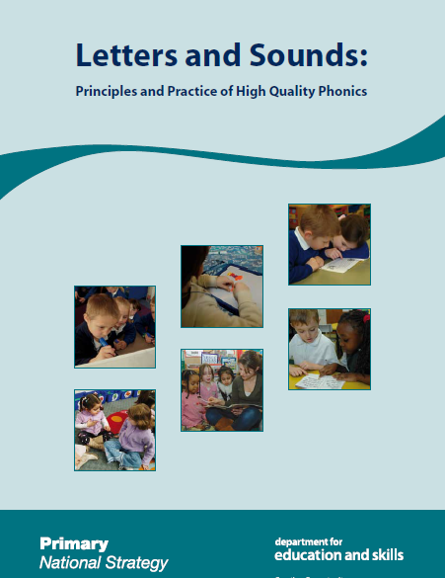

Slide 14
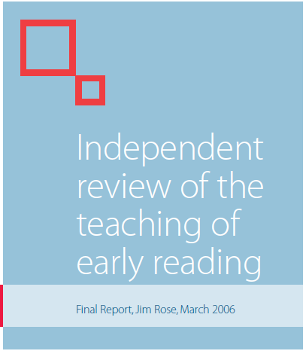
Evidence for synthetic phonics
“Having considered a wide range of evidence, the review has concluded that the case for systematic phonic work is overwhelming and much strengthened by a synthetic approach.”– Rose (p.21 2006)
Supporting Evidence: Johnston & Watson (1997); Johnston & Watson (2004); Johnston & Watson (2005); Johnston, McGeown, & Watson (2012)
Critique of Evidence: (Wyse & Goswami, 2008; Wyse & Styles, 2007)
Notes:
Not to go into too much depth with this area as it is the evidence base for other interventions that we have already seen.
Quite a lot of evidence on the JP website and in publications relates to Johnson and Watson whose later studies continue to show improvements in phonemic awareness and reading ability for synthetic phonics over analytic phonics. It is not clear though that the programme they use is JP although it sounds very much like it. This evidence is the key evidence base which the Rose review based its recommendations on.
Rose cites research from Insight - a publication of the research group within Information, Analysis and Insight Communication Division, which is responsible for providing analytical services within the Scottish Executive Education Department (SEED).
This is a summary of studies by Johnson and Watson: Clackmannanshire studies – see separate notes
They have continued studying this area. -A comparison was made of 10-year-old boys and girls who had learnt to read by analytic or synthetic phonics methods The boys taught by the synthetic phonics method had better word reading than the girls in their classes, and their spelling and reading comprehension was as good. In contrast, with analytic phonics teaching, although the boys performed as well as the girls in word reading, they had inferior spelling and reading comprehension. Overall, the group taught by synthetic phonics had better word reading, spelling, and reading comprehension. There was no evidence that the synthetic phonics approach, which early on teaches children to blend letter sounds in order to read unfamiliar words, led to any impairment in the reading of irregular words.
Not the only studies to support synthetic approach - E.g. Carol Torgerson’s work
Even Rose acknowledges that there is criticism of this research methodology but backs up with own observations and OFSTED ratings.
Critiques: Wyse – see separate notes

Slide 15
Evidence for a Multisensory Approach
Joshi, Dahlgren and Boulware-Gooden (2002)
A multi-sensory approach to phonics instruction led to higher gains than controls for phonological awareness, decoding and comprehension.
Campbell, Helf and Cooke (2008)
Adding multisensory components to a reading intervention allowed children to acquire basic decoding skills
Kristen & Goeke (2006)
Additional research is needed before sound
conclusions can be drawn about the
effectiveness of the OG approach
Puff out the candles on my pink pig cake
P,P,P,P,P
Notes:
In OFSTED rating outstanding phonics lessons multisensory approaches were used. – Rose report.
Kristen & Goeke (2006)
A review of the OG approach which concluded that due to the small number of studies, a lack of methodological rigor and inconclusive findings , additional research is needed before sound conclusions can be drawn about the effectiveness of this approach
Both synthetic and multi-sensory elements have had some evidence to support – it is not conclusive but perhaps more extensive than many school-based interventions.
However its hard to unpick which element may be most effective – which aspect is it important to maintain.

Slide 16
Implications
An evidence based approach
Effective with a variety of different needs
Consider the rationale for schools choosing this approach
Intervention should be tailored to the individual
May not be suited to older learners
http://jollylearning.co.uk/shop/
We lick our lollipops, L,L,L,L
Notes:
Evidence based – supports EAL children, children from low SES backgrounds, children with a developmental condition, children who have not responded to other forms of class based teaching of phonics
Evidence does need to be carefully considered, e.g. it is from around the world and often involves using other approaches simultaneously.
EP’s should encourage choice based on appropriateness and evidence not just ease of delivery - Cost of the intervention (see website) – nothing to stop schools creating their own versions based on letters and sounds or other synthetic approaches. Just takes more time.
phonological awareness is a precursor to skilled reading – but some children struggle with phonemic awareness or memory issues required to segment, blend, combine and hold on to the meaning. Therefore there will always be some children for whom this approach is not well suited. Choices should be tailored to child not because it is manualised
Is rather young for use with older children who may require phonics intervention (own experience) – all studies use children who are in their first 2 years of formal schooling except down syndrome. Could be very demotivating to self-confidence if feel that are working on something for young children

Slide 17
Summary
A synthetic phonics approach based on cognitive principles
Multisensory methods
Subject to investigation from independent sources
Wonders
Is it more or less effective than any other synthetic or multisensory approach?
Is it always appropriate to the needs of the
learner?
With a D, D, D, D, D, D,D
See me play upon my drum
Notes:
A synthetic approach to teaching phonics based on the understanding that phonological awareness is the first cognitive skill required in the process of learning to read.
Learning is supported through multisensory methods
Independent evidence supports the use of this approach
I would conclude that this approach has it’s place – we need to be critical of evidence and make sure it is used for the right reasons but there is nothing to suggest that this approach is not worth trying.
I’m left wondering
It has not been proven to be more or less effective than any other synthetic or multisensory approaches so why would schools go for this? Cost? Ease of delivery.
Schools who wish to use it have to consider if it is appropriate to the needs of the learners for which it is intended. What is our role in this?

